Slide 1

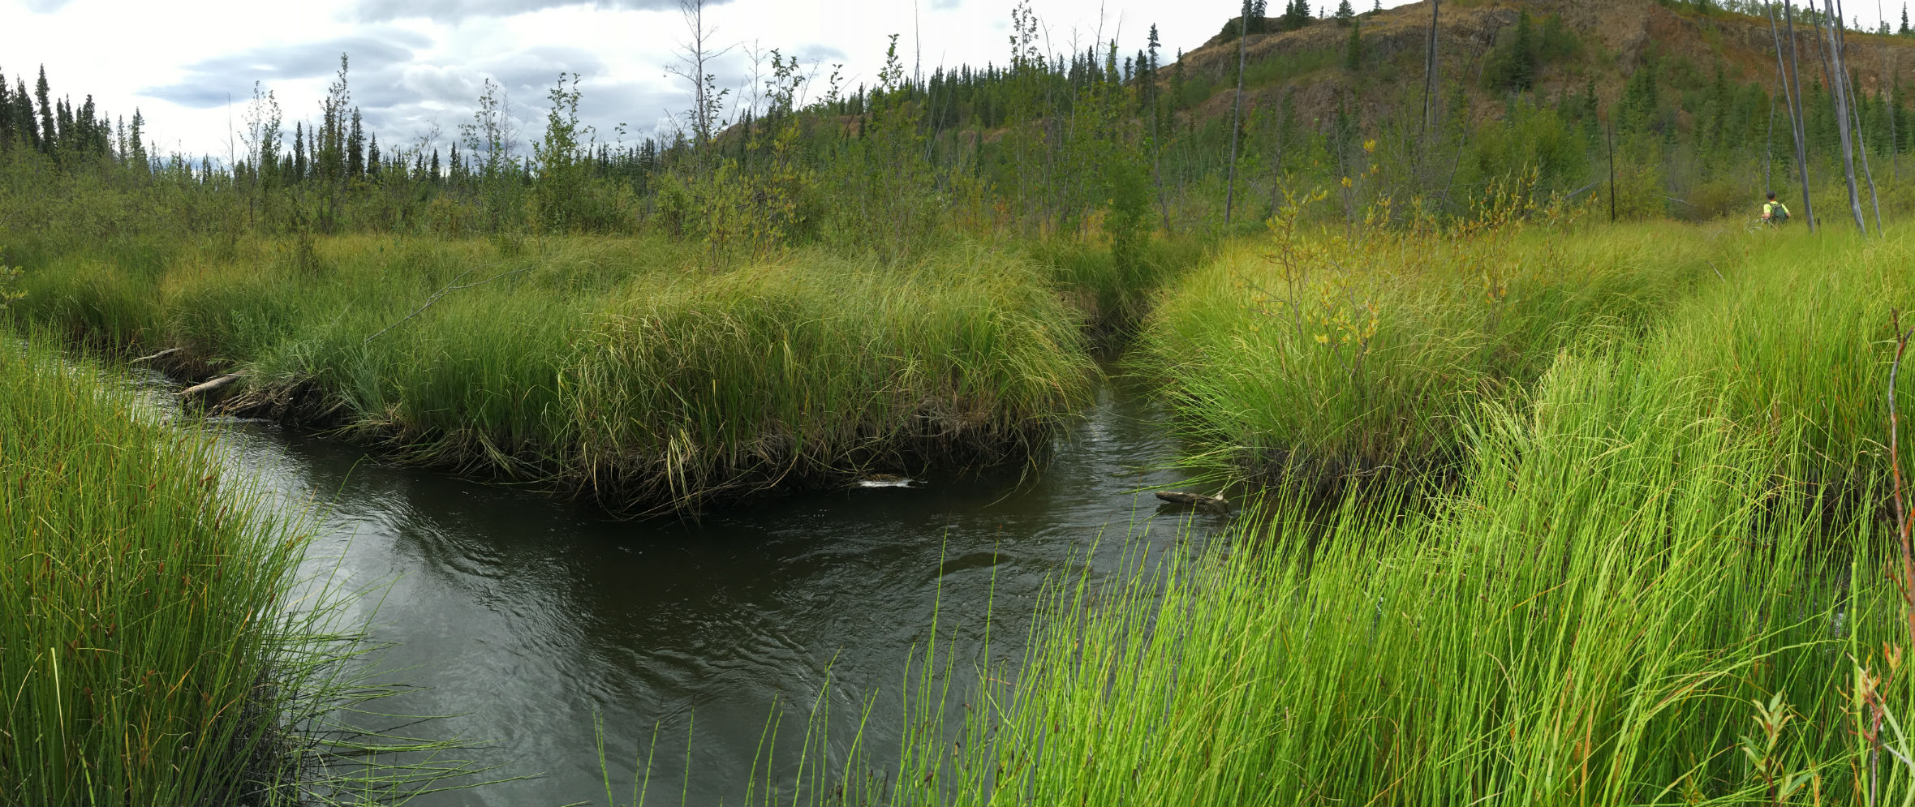
Ta'an Kwäch'än Council
Fox Creek Chinook Salmon Stock Restoration Project
December 2017
Notes:
Recent Activities
Ta'an Kwäch'än Council
Fox Creek Chinook Salmon Stock Restoration Project

Slide 2
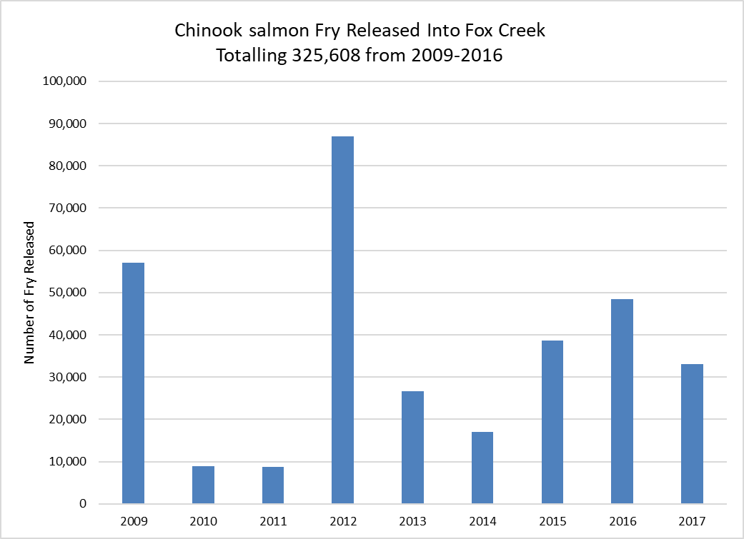
Background
Notes:
Background
According to Ta’an Kwäch’än Elders, Fox Creek historically supported a Chinook salmon fishery
Since the late 1950’s the stock disappeared and the cause is unknown
From 2007 to 2015 Ta'an assessed, developed and implemented Phase I of the Fox Creek Chinook Salmon Stock Restoration Project
Phase I suggested stock restoration continue for 2 Chinook salmon life cycles
In 2015 Ta'an developed the Phase II plan to complete the 2nd life cycle
The first fry were released in the creek in 2009
annually since
Number released to date 326,000

Slide 3
Goal
Ta’an Kwäch’än Council’s goal for the Fox Creek Salmon Chinook Salmon Restoration Program is to re-establish a self-sustaining population of Chinook with sufficient spawners to have a high probability of long-term persistence.
Ta'an aims to ensure that a viable natural stock is abundant enough to contribute to a sustainable harvest for current and future generations as part of their natural culture and heritage.
Notes:
Goal
Fox Creek Project is to re-establish a self-sustaining population with sufficient spawners to have a high probability of long-term persistence, in the face of many changes.
Ta'an aims to ensure that a viable natural stock is abundant enough to contribute to a sustainable harvest for current and future generations as part of their natural culture and heritage.

Slide 4
Fox Creek Project Components
Planning and Implementation | Bio-physical Monitoring Juveniles
Training and Capacity Building | Hydrology and Water Quality
Broodstock Collection, Incubation and Rearing | Trail Maintenance
Annual Fry Releases | Monitoring Adult Returns and Barriers
 | Redd Monitoring
Notes:
Fox Creek Project Components
Planning and Implementation
Training and Capacity Building
Broodstock Collection, Incubation and Rearing
Annual Fry Releases
Bio-physical Monitoring of Juveniles
Hydrology and Water Quality
Trail Maintenance
Monitoring Adult Returns and Barriers
Redd Monitoring

Slide 5





Planning and Implementation
Notes:
Planning and Implementation
Project Partners
Yukon River Panel – Major Funder for the entire project since 2008
Yukon Energy – Owns & Operates the Whitehorse Fishway and Whitehorse Rapids Fish Hatchery – Donated eggs for the project since 2009
Yukon College – Owns & Operates McIntyre Creek Incubation Facility – Raise eyed eggs to the fry stage and prepare them for release
Department of Fisheries and Oceans & Yukon Salmon Sub-Committee – Technical support and advice
Ta'an coordinates pre and post-season meetings with project partners
Partners provide ongoing support Ta'an and increase our knowledge and experience
Thank you to all our partners hard work, we could not do this project without you!

Slide 6
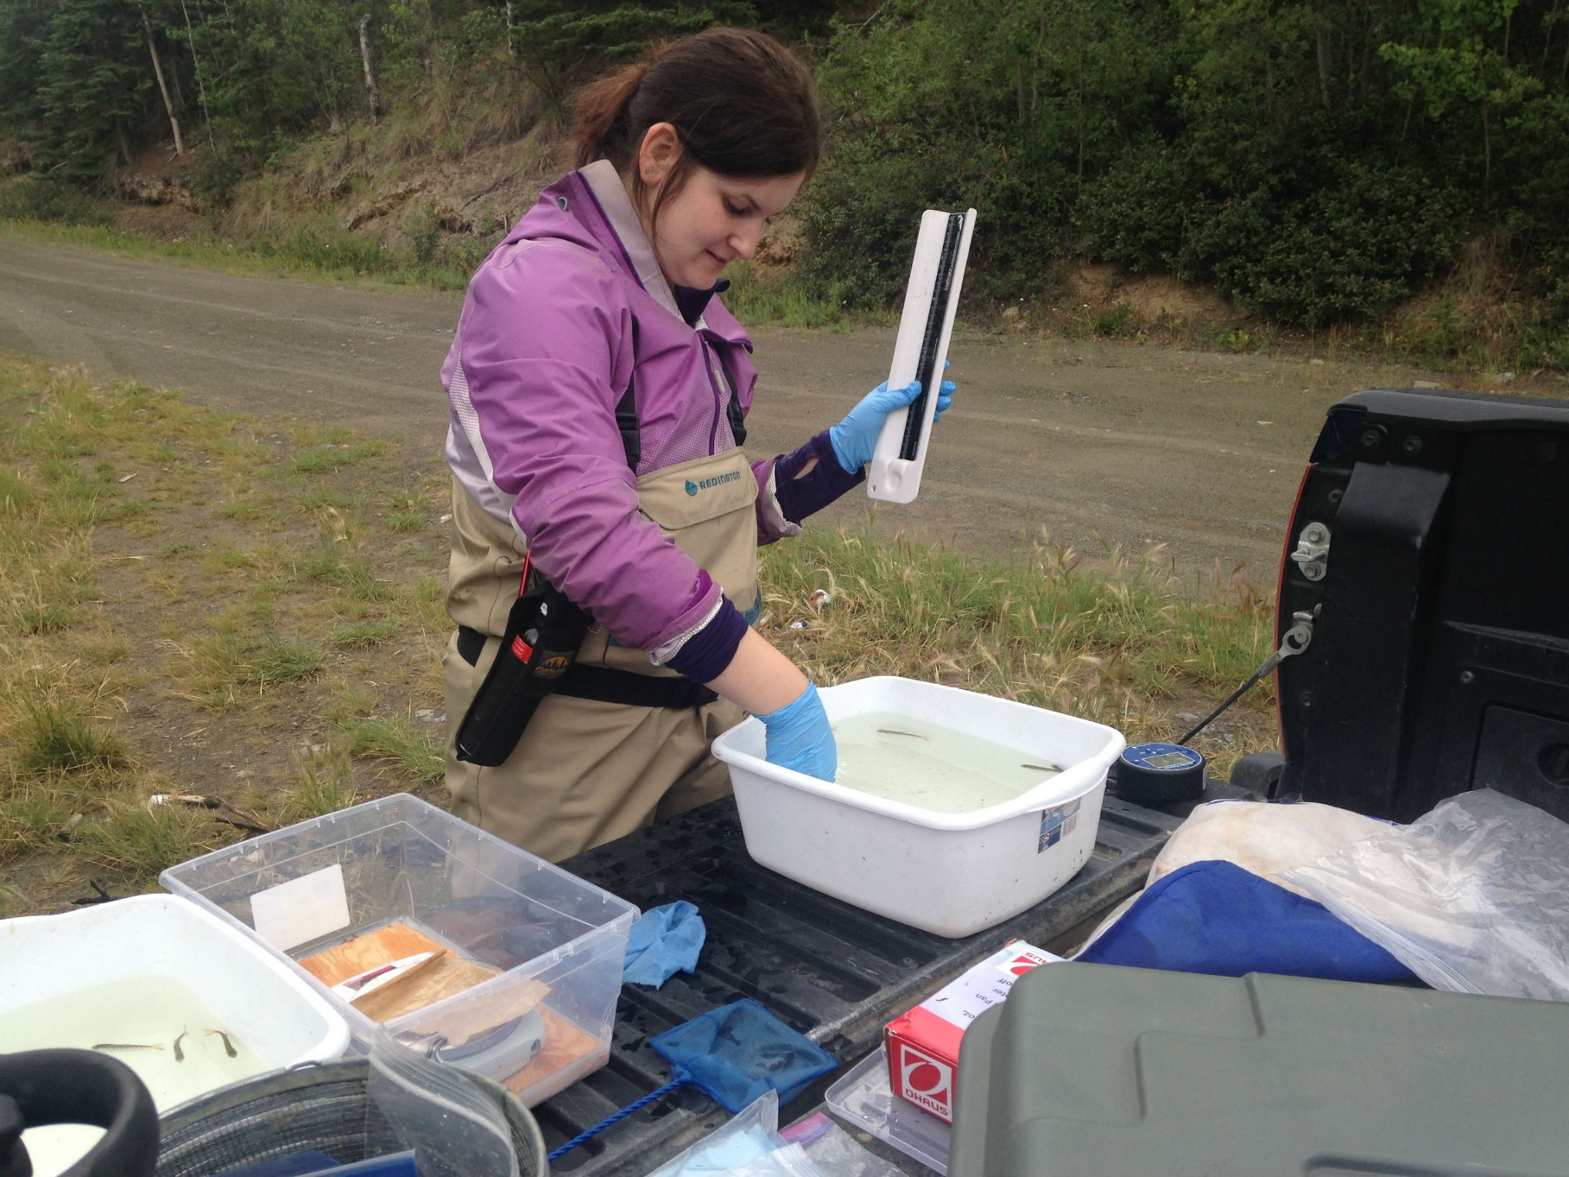
Training & Capacity Building
Notes:
Training & Capacity Building Strategies
Employ young Ta'an citizens
Formal training – 2016 - 4 staff certified as fisheries techs
Mentorships with partners and other agencies.
Allow interested staff to work on project
Link project activities and goals, to existing Ta'an programs such as Culture, Family, and Fish Camps.
Involve Ta'an citizens through presentations, newsletters, and website
Public events – annual fry release
Educate about the Chinook salmon decline, best practices and conservation

Slide 7
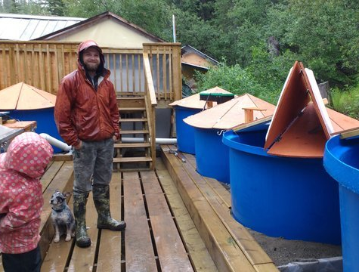
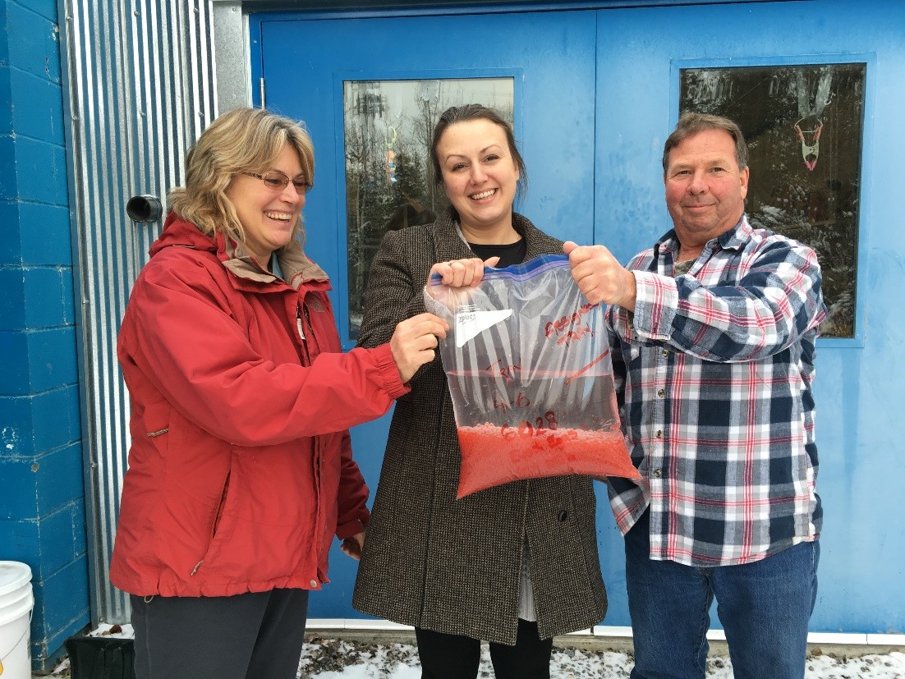
Broodstock Collection, Incubation & Rearing
Notes:
Broodstock Collection, Incubation & Rearing Component
Yukon Energy - Collects broodstock at Whitehorse Rapids Fishway, fertilize them, and raise eggs to the eyed stage
Ta'an transfers the eggs to MCIF
Yukon College operates MCIF
Students at Yukon College gain practical experience and raise eggs until fry are ready for release
Assist with applying coded wire tags and adipose fin clipping
Ta'an opportunity to assist with operations and maintenance
Ta'an transfers the fry to Fox Creek

Slide 8
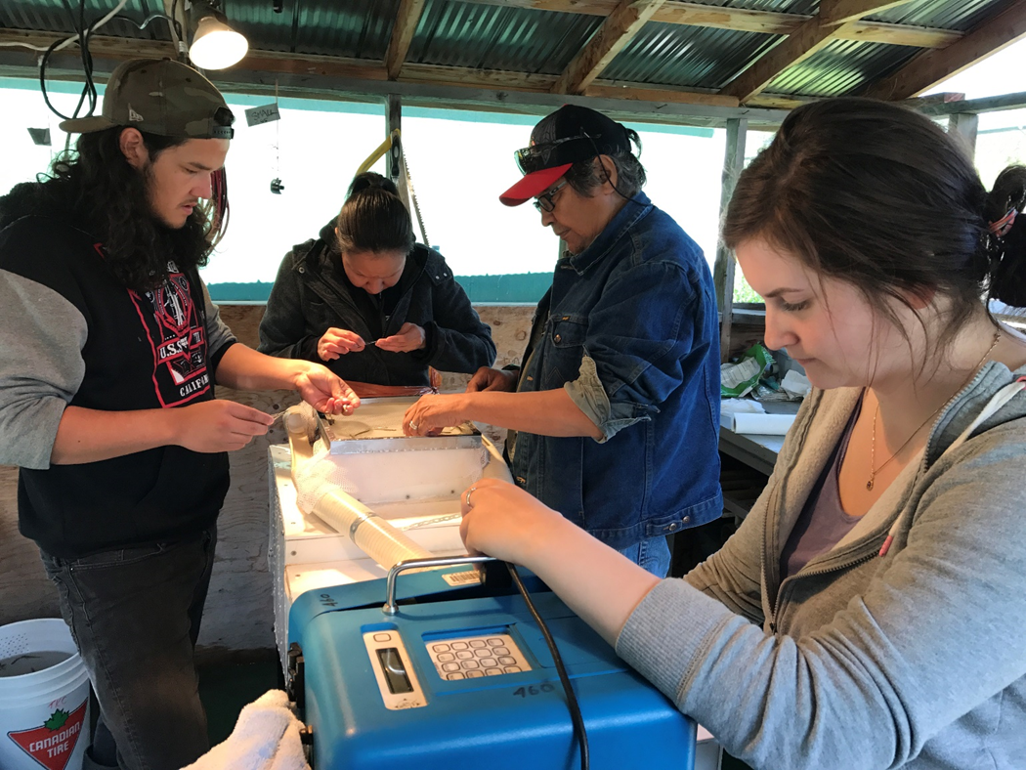
Applying coded wire tags and clipping adipose fins
Notes:
In 2017; DFO offered Ta'an excellent opportunity to train Jenna to apply coded wire tags.
She trained under an experienced tagger at WRFH in June.
She then lead the tagging efforts at MCIF in July
Many Ta'an staff participated in the clipping adipose fins.

Slide 9
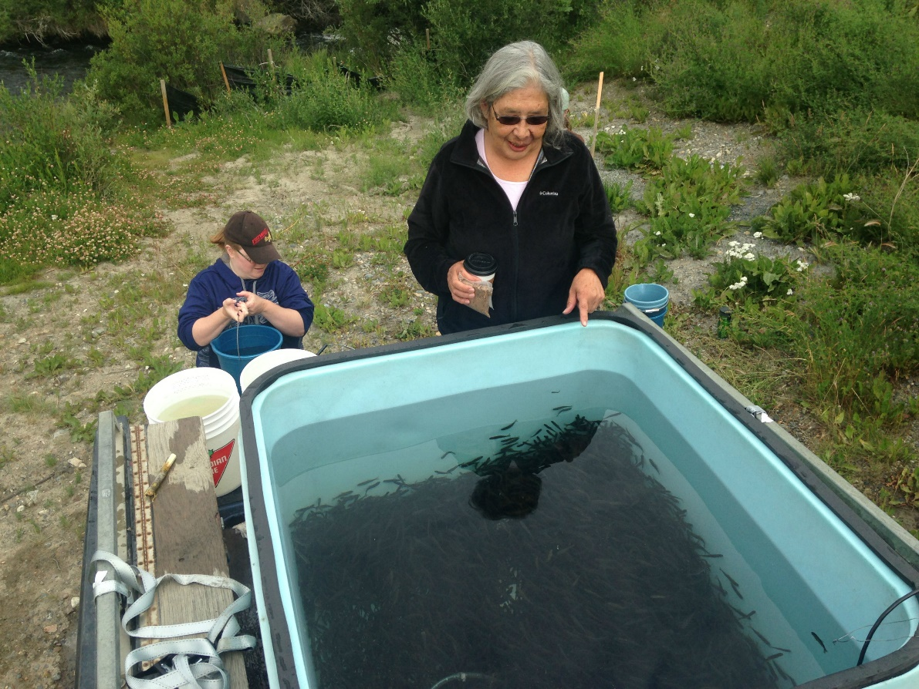
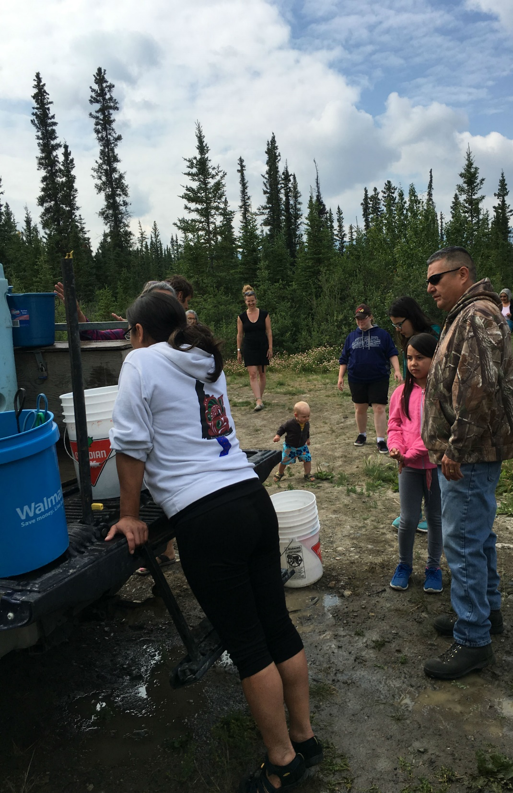
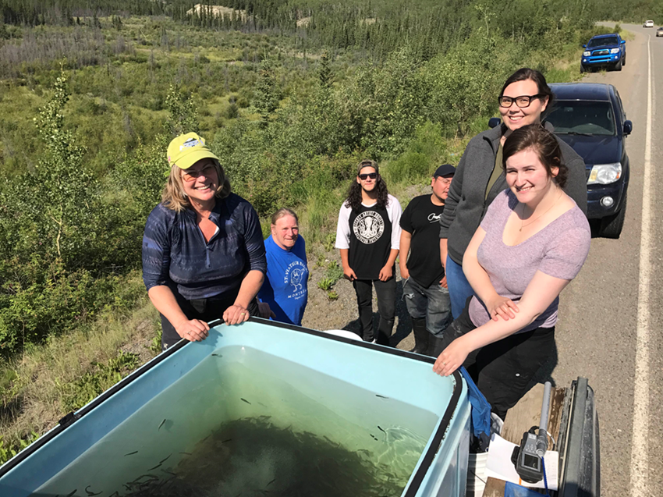
Notes:
Annual Fry Release
Takes place in mid July shortly after the coded wire tagging
It has become and very positive event for Ta'an staff, citizens, and the public
Attendance is increasing each year
In the past we released only at the bridge but in 2016 and 17 we also released upstream of the bridge at juvenile monitoring Site 1

Slide 10
Bio-physical Monitoring of Juveniles
Notes:
Four Monitoring Stations for our Bio-physical Monitoring of Juveniles
Monitor monthly during field season
Monitor 2 times before release (May and June) to determine overwintering
Monitor 3 times after release to determine distribution and growth rates
Monitoring takes 2 days; on the first day we set traps, the next morning we retrieve them
We take a sample size of 30 fish at each site.

Slide 11
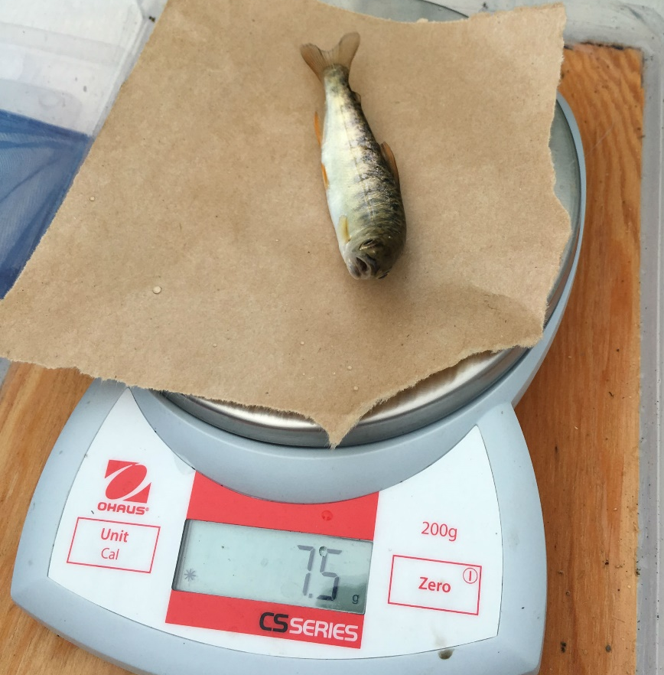
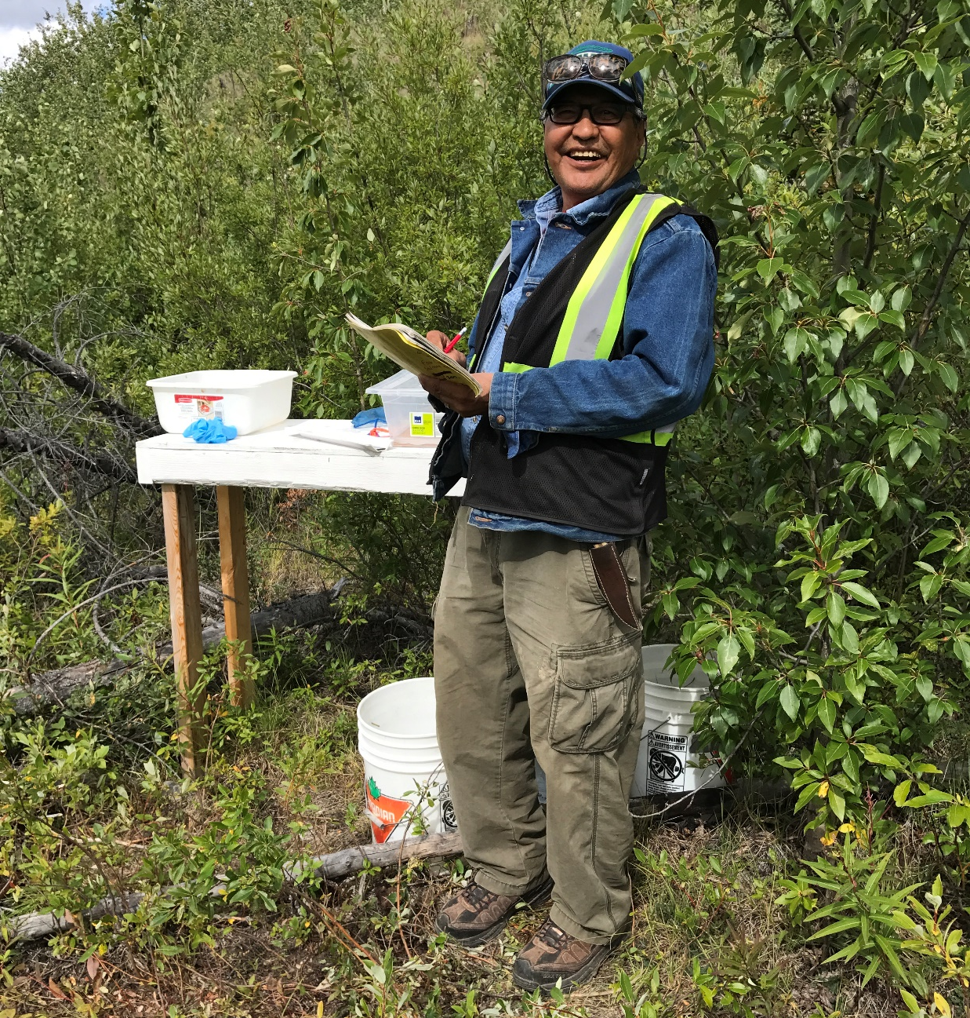
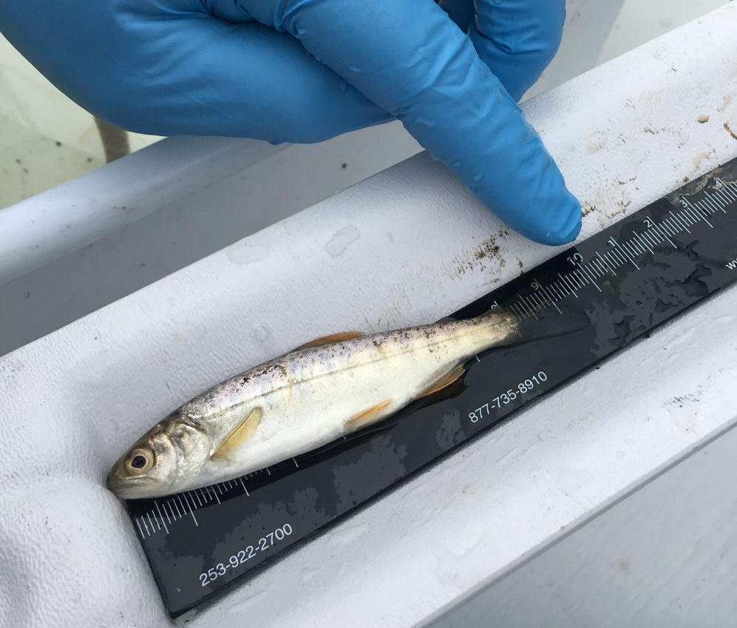
Bio-physical Monitoring of Juveniles
Notes:
Here is Testloa Smith

Slide 12
Monitoring Date | Parameter | MS08-01 | MS08-02 | MS08-03 | MS08-04 | TOTAL # of Chinook
May 19/17 | # of Chinook | 1 | 4 | 5 | 1 | 11
 | Avg Weight (g) | 5.6 | 4.1 | 4.7 | 3.9
 | Avg Length (mm) | 80 | 74 | 79 | 75
 | Unclipped # and % |  |  | 1 | 1 | 2 = 18%
June 9/17 | # of Chinook | 0 | 0 | 6 | 0 | 6
 | Avg Weight (g) | N/A | N/A | 5.8 | N/A
 | Avg Length (mm) | N/A | N/A | 82 | N/A
 | Unclipped # and %
July 26/17 | # of Chinook | 32 | 27 | 4 | 0 | 63
 | Avg Weight (g) | 1.4 | 1.8 | 3.9 | N/A
 | Avg Length (mm) | 52 | 57 | 71 | N/A
 | Unclipped # and % |  | 1 | 4 |  | 5 = 7.9%
August 16/17 | # of Chinook | 41 | 119 | 1 | 0 | 161
 | Avg Weight (g) | 2.2 | 2.1 | 3.3 | N/A
 | Avg Length (mm) | 61 | 61 | 70 | N/A
 | Unclipped # and % | 4 |  |  |  | 4 = 2.5%
September 14/17 | # of Chinook | 41 | 31 | 8 | 0 | 80
 | Avg Weight (g) | 2.9 | 3.0 | 6.1 | N/A
 | Avg Length (mm) | 67 | 66 | 84 | N/A
 | Unclipped # and % | 6 |  | 8 |  | 14 = 17.5%
October 18/17 | # of Chinook | 31 | 26 | 2 | 0 | 59
 | Avg Weight (g) | NT | NT | NT | N/A
 | Avg Length (mm) | 71 | 67 | 87 | N/A
 | Unclipped # and % | 1 |  | 2 |  | 3 = 5%
TOTAL |  | 146 | 207 | 25 | 1 | 379
Total Unclipped |  | 11=8% | 1=0.5% | 15=60% | 1=100% | 27 = 7%
Notes:
We are starting to track the number of fry with and without adipose fins clipped.
We plan to use a v-notch detector to determine if unclipped fry are potentially wild stock
We will track the ratio of unclipped to clipped each year

Slide 13
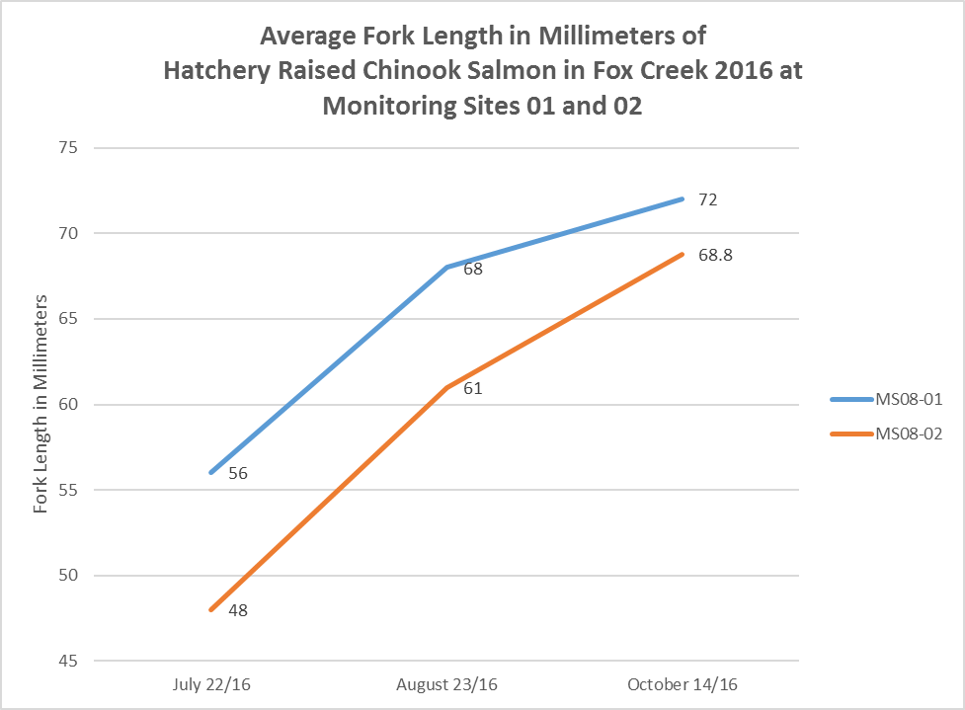
Growth Rates After Release
Notes:
By releasing at two sites we have an opportunity to see if density effects growth rates
In 2016; 35,000 fry were released at Site 2 (red) and 11,000 at Site 1 (blue)
Although preliminary, it appears density does reflect growth rate due to less competition for nutrients
Project staff also observed the fry at Site 1 appeared more robust

Slide 14
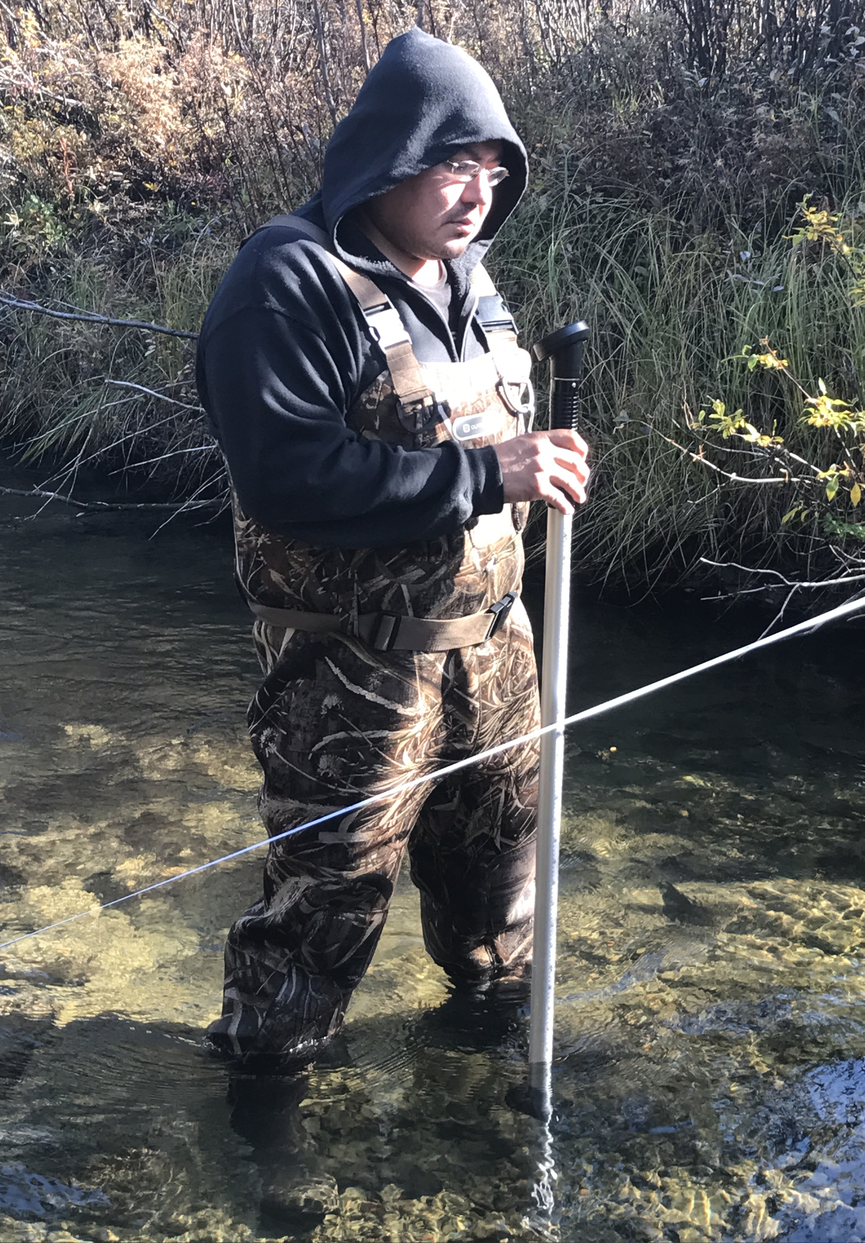
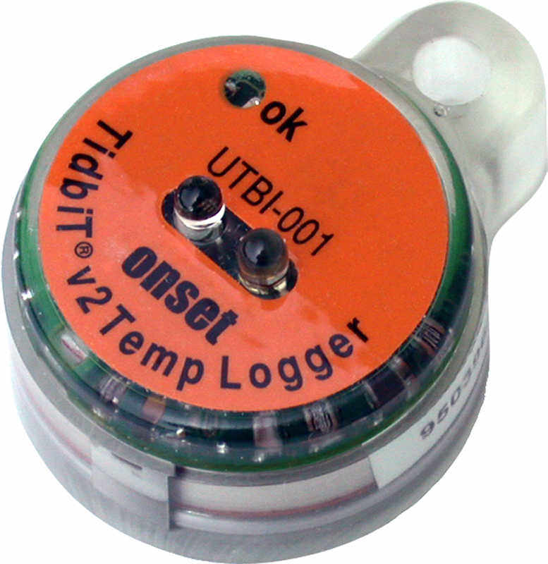
Hydrology and Water Quality
Notes:
Hydrology and Water Quality
During monthly Bio-Physical monitoring events we measure discharge and in-situ water quality (DO, pH, Cond, and Temp)
Take under ice; discharge, water quality samples and in-situ measurements (particularly DO) during winter
Fox Creek is also part of Ta’ans long term water temperature monitoring program
This program measures water temp year round - every hour on the hour, at various locations in Ta’an TT using Tidbit v2 loggers
Stan Clethroe

Slide 15
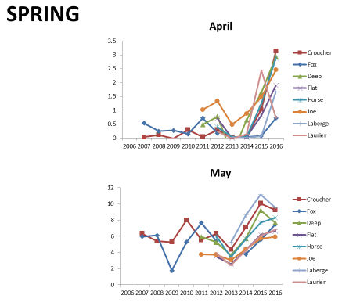
Water Temperature Trends
Notes:
In the winter of 2016 and 17 Ta’an hired PhD student Ellorie McKnight to analyze the data and develop user friendly data management and presentation methods
Although preliminary; Ellorie’s results indicate increasing spring surface water temp in various creeks within Ta’an TT

Slide 16
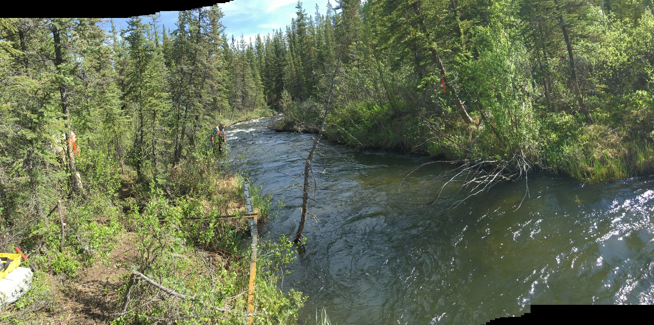
Hydrometric Station
Notes:
Ta'an committed to install a hydrometric station, in the 2017 operating year
We contracted Laberge Environmental Services who trained staff on installation, operation and analysis

Slide 17
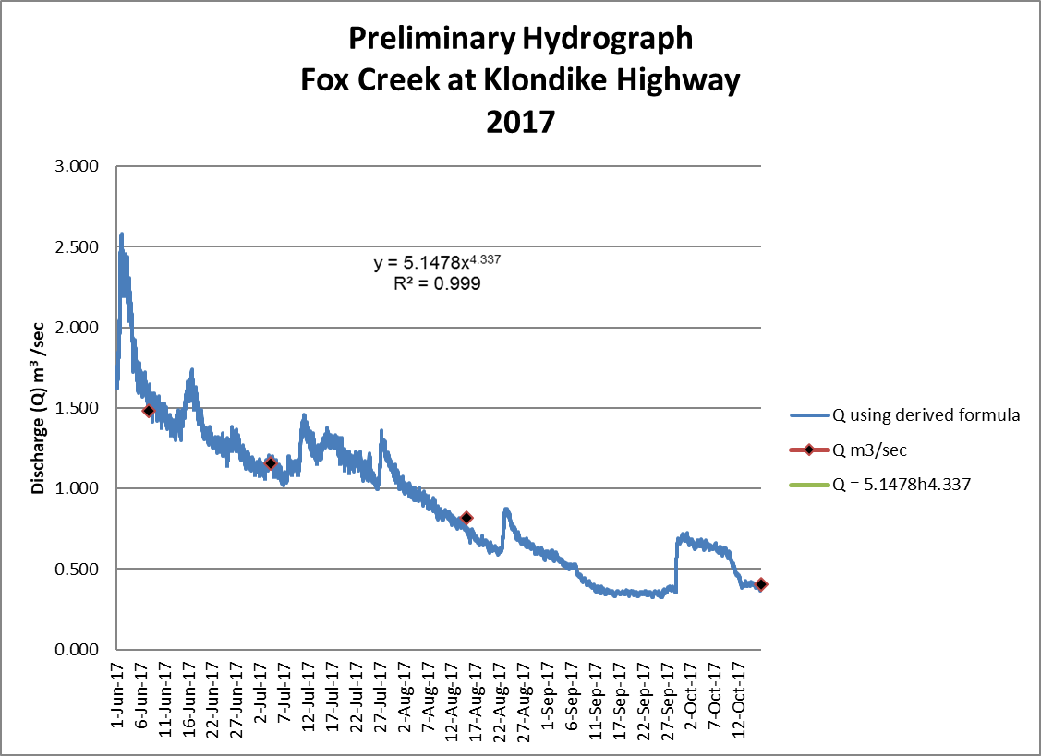
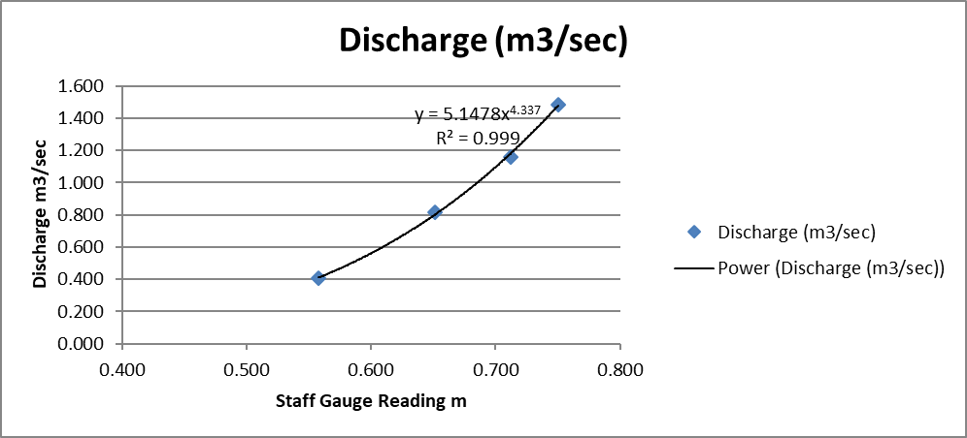
Hydrometric Results
Notes:
Here are some very preliminary results from this first year of operation
The goal of the hydrometric station is to develop a rating curve over time
The purpose of the rating curve is; by reading the staff gauge we can determine the discharge
Eventually we may not have to jump in the creek and get all wet to get a discharge measurement

Slide 18
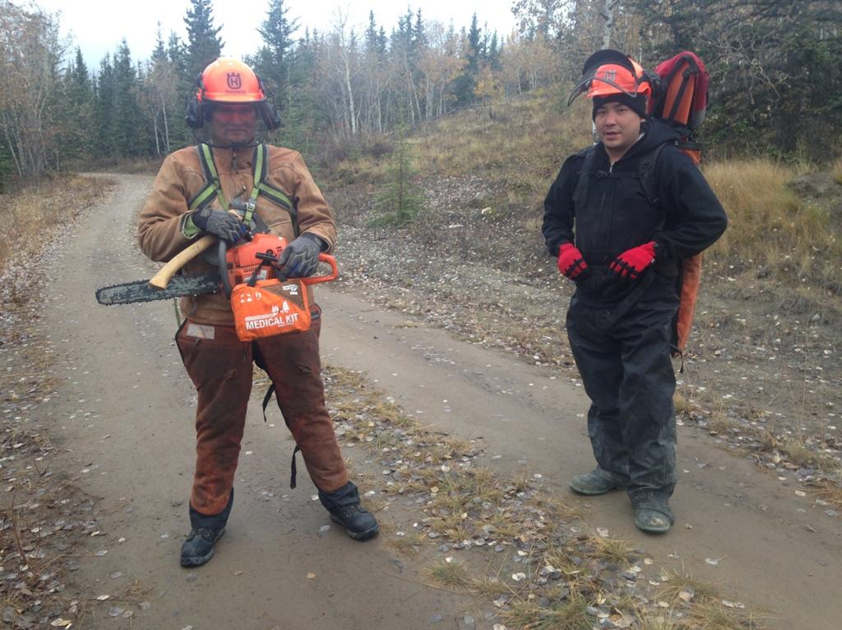
Trail Maintenance
Notes:
Ongoing trail maintenance for easy and safe access is a very important part of the project
We utilize the Ta’an Firesmart crew who is already trained and mobilized to do this
John Bunbury and Clayton Kane

Slide 19
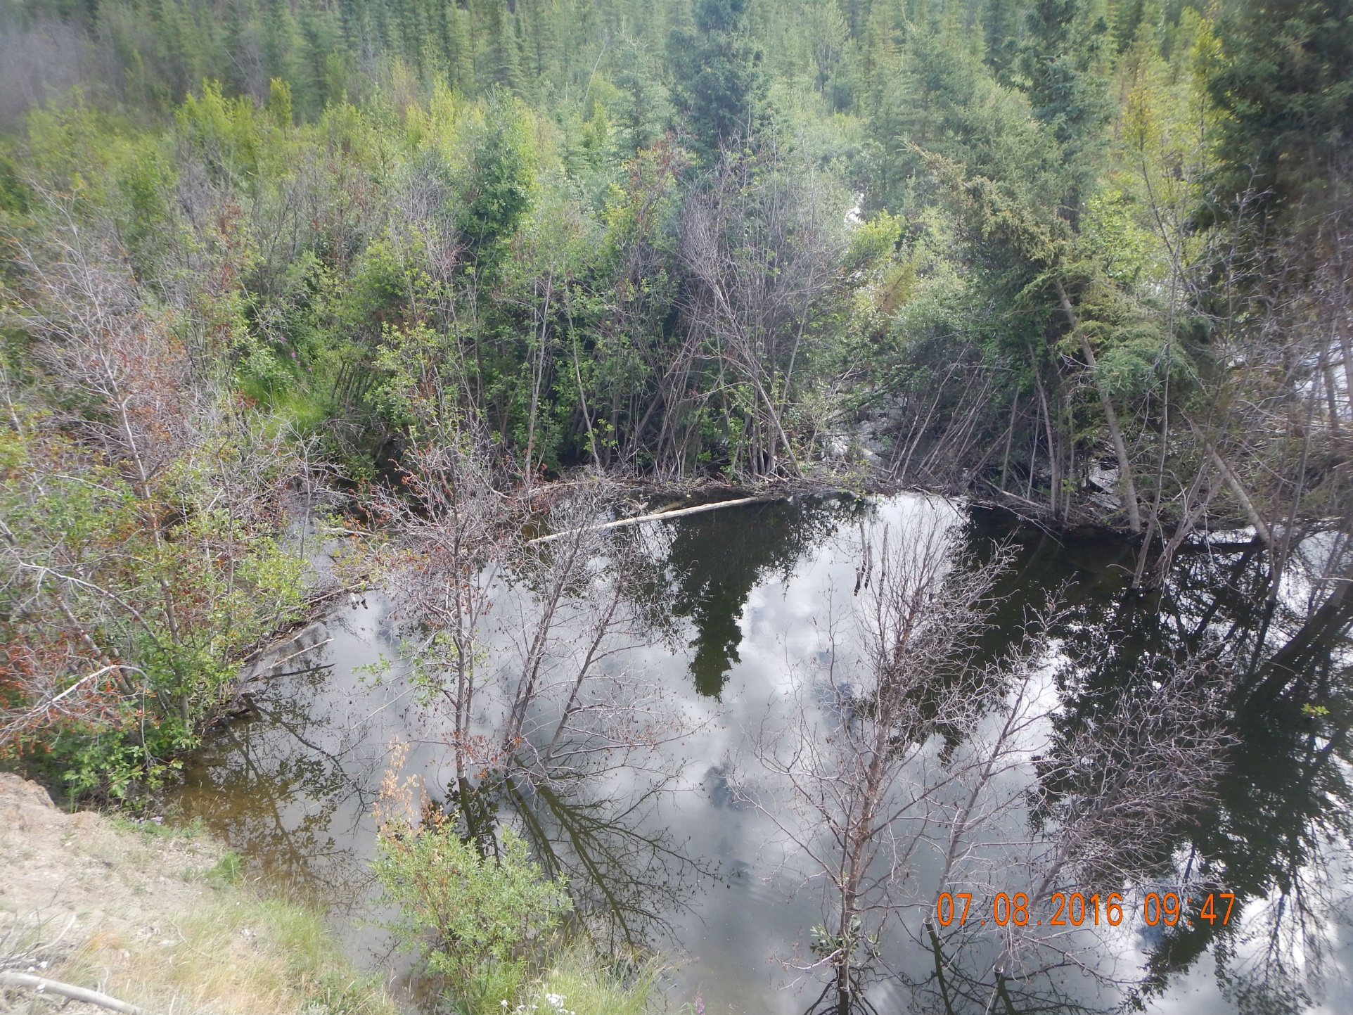
Monitoring Adult Returns & Barriers
Notes:
Monitoring Adult Returns & Barriers
July - conduct a stream walk
Record beaver activity and other obstructions to migrating adult salmon
Remove obstructions if we can
Monitor adult salmon returns through daily stream walks and continual notching of beaver dams to move salmon up the stream
We are also conducting ongoing beaver trapping to reduce beaver activity

Slide 20
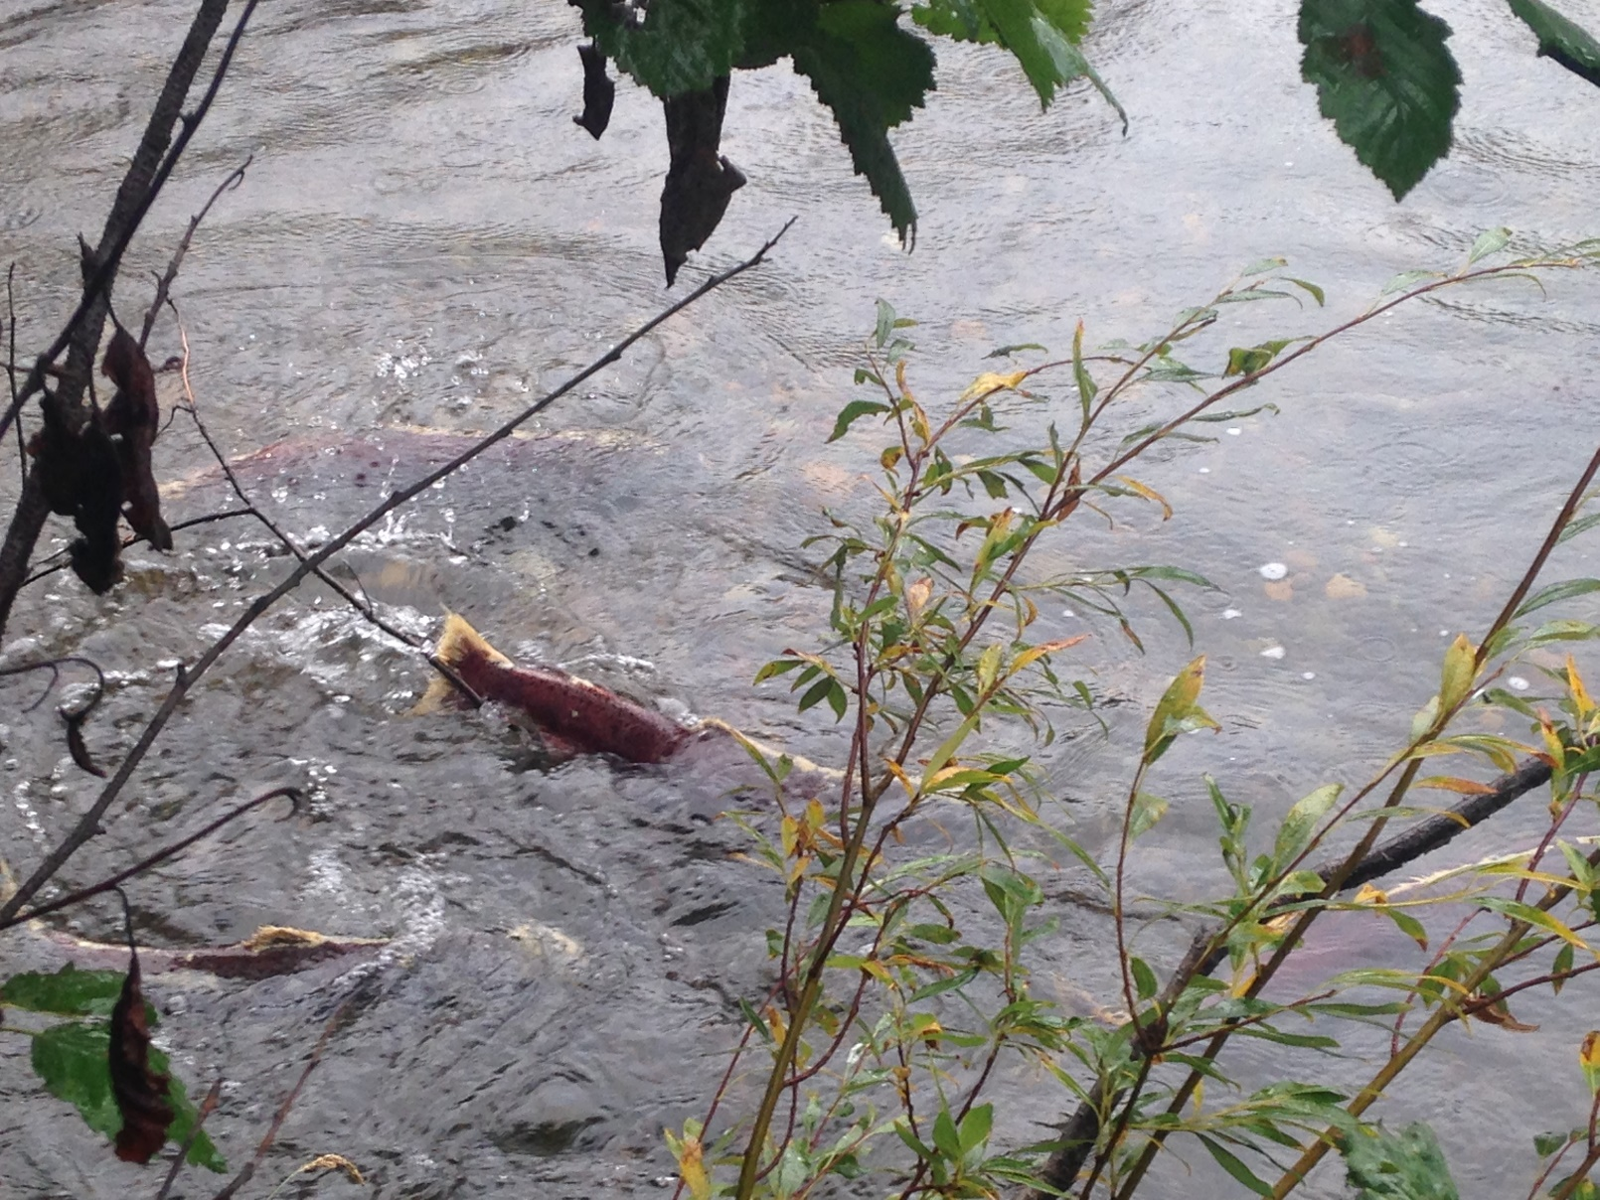
Monitoring Adult Returns & Barriers
Notes:
On our daily stream walks we record the number of returns and their location
We also watch for spawning behaviour to determine location of potential redd sites (or nests)
And we collect adult carcasses for DFO to analyze

Slide 21
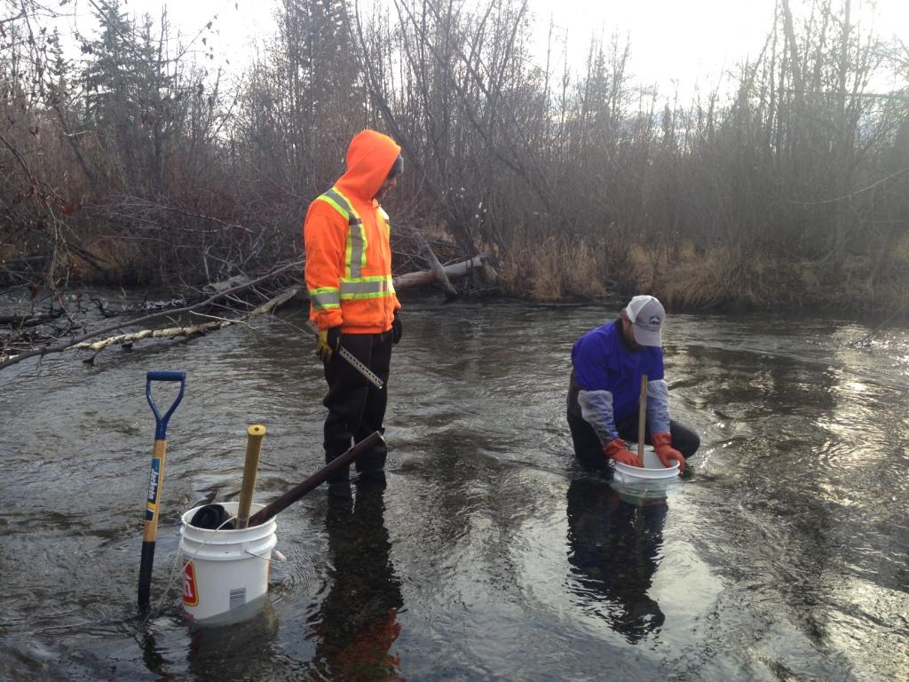
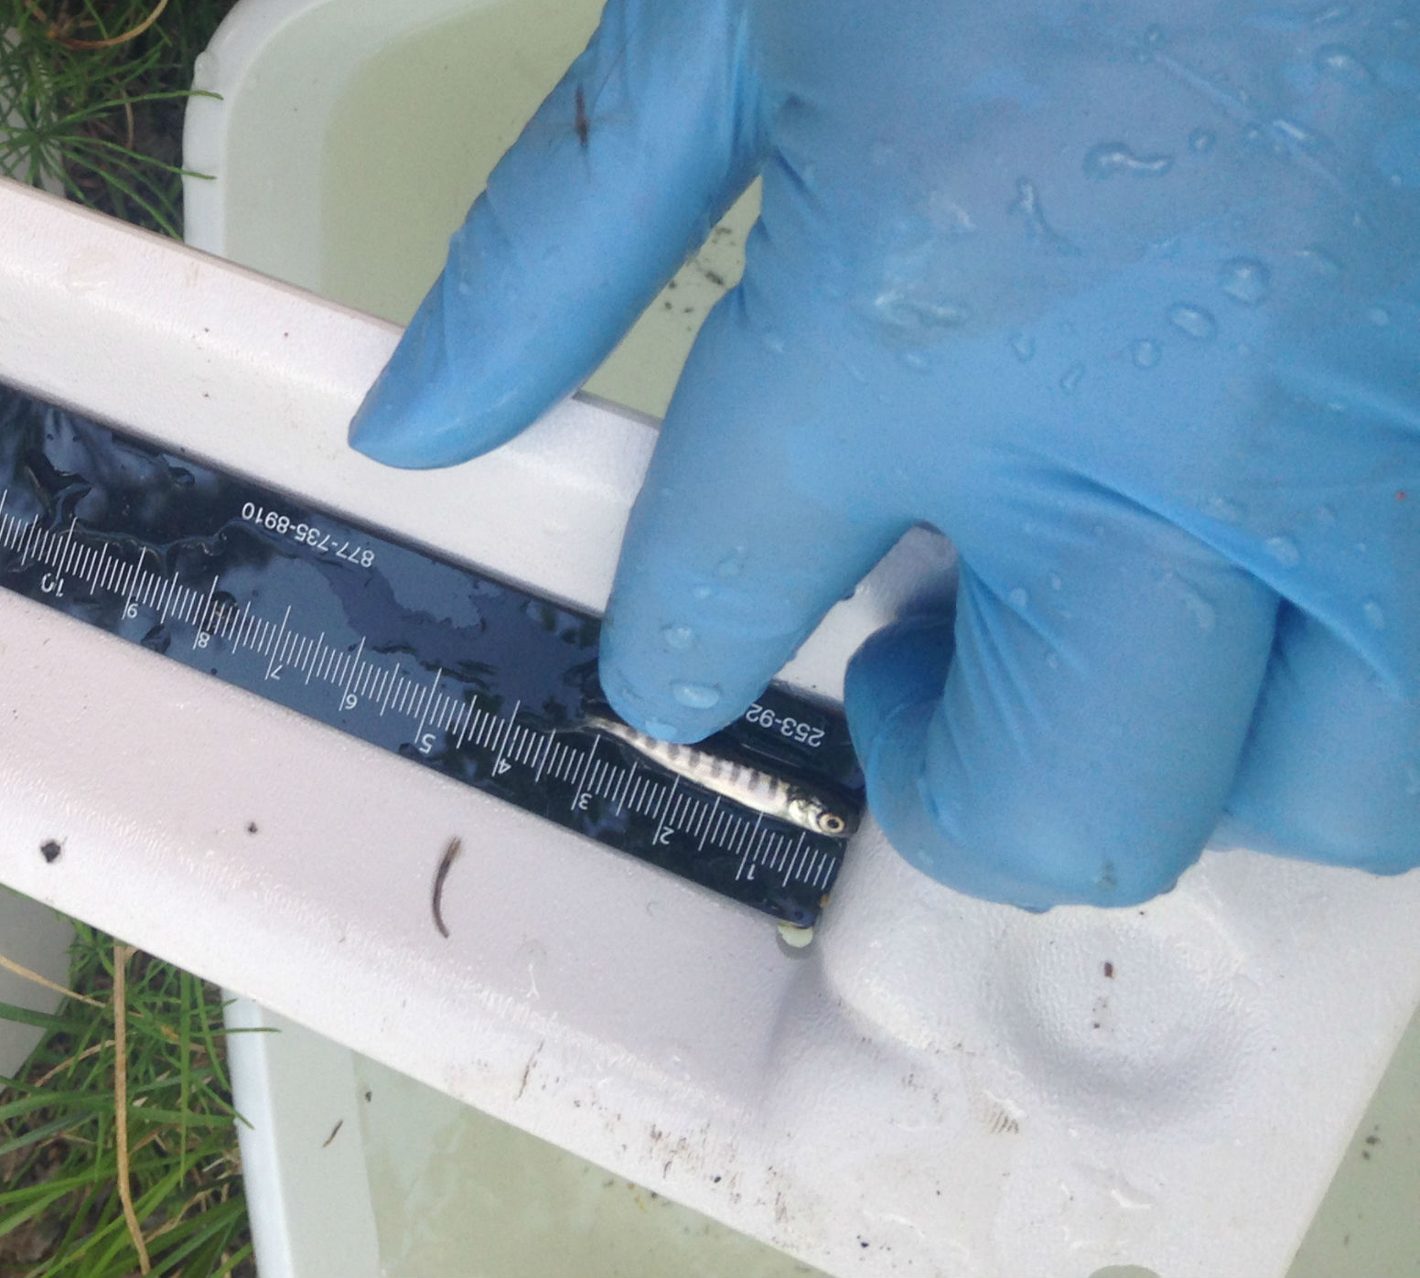
Redd Monitoring
SUCCESSFUL SPAWNING!
Notes:
Redd Monitoring
Adjacent to potential redds we install artificial redds again using tidbit temp data loggers
We do this to calculate Accumulated Thermal Units to 1000 or the time of emergence
At 1000 ATU or about early June we conduct bio-physical monitoring of emerging 0+Young of Year
In both 2016 and 2017 recorded wild young of year emerging from the substrate.
SPAWNING SUCCESS!!!

Slide 22
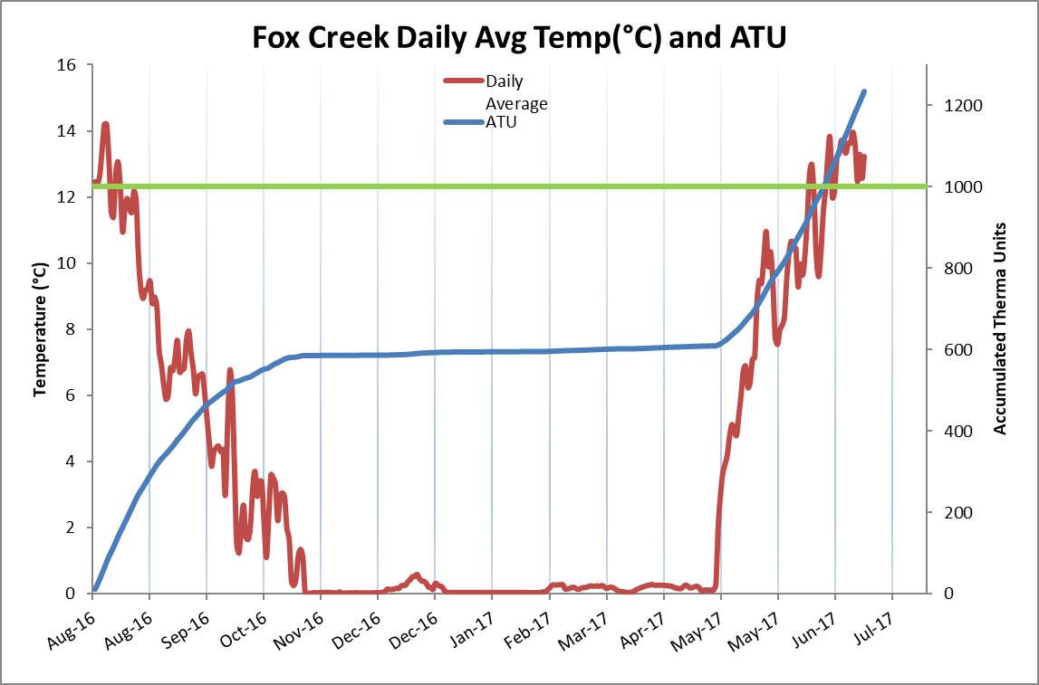
Notes:
Here are the results of one of the temp loggers showing 1000 ATU’s or time of emergence at the beginning of June

Slide 23
Project Year | Year of Fry Release | Planning and Implementation | Broodstock Collection, Incubation and Rearing | Releases | Bio-physical Monitoring of Juveniles | Hydrology and Water Quality | Monitoring Adult Returns and Barriers | Redd Monitoring
9 (2016) | 2012 | Develop data collection sheets for project components. Develop spreadsheets or database to house all monitoring data. A central location for all data to allow easy access for multi-year analysis. | Maximize genetic diversity by utilizing Whitehorse Rapids Fish Hatchery for broodstock collection and rearing to the eyed stage. Utilize MCIF for rearing to fry stage and assist with monitoring, daily maintenance and operations. | Consider staggering release dates and possibly re-evaluating release locations to accommodate the numbers of fry. | Ongoing annual activities guided by implementation and monitoring plan. (IMP). | Conduct winter water quality monitoring with parameters; dissolved oxygen, pH, turbidity, ORP, conductivity, Nitrates, and total metals. As per the Restoration Plan 2008 recommendations, stream gauging and flow measurements should be conducted during regular monitoring events to improve discharge data. | Conduct stream walk surveys both before spawning period and daily during and after. Digitize and map reaches of stream morphology including barriers, spawning and rearing habitat that have been photographed and geo-referenced | Conduct daily stream walk surveys during spawning period.
10 (2017) | 2013 | Move toward digital data entry in the field with appropriate instruments. Gain knowledge and understanding on the marine ecology, the Yukon River system and Alaskan Tribal communities. | Maximize genetic diversity by utilizing Whitehorse Rapids Fish Hatchery for broodstock collection and rearing to the eyed stage. Utilize MCIF for rearing to fry stage and assist with monitoring, daily maintenance and operations | Discuss option of not inserting Coded Wire Tags with SEP, Jason Hwang. Cannot clip adipose fin. Stagger release dates and locations to accommodate the numbers of fry. Approach to estimating rearing capacity of the system should be developed and refined. (IE: assumption of 1m2/fry is likely reasonable but total habitat needs to consider beaver activity, creek length and width) | Annual IMP activities Add data from 2017 biophysical monitoring to 2009 – 2016 analysis document. | Continue year-round water quality and discharge measurements. Determine water quality standards to be used. Install a hydrometric station, including a staff gauge to develop a rating curve over time. | Conduct stream walk surveys and develop interim additional methods to enumerate returning adults. Due to bear activity in the area this is a safety issue therefore high priority. Actively manage beaver to restore unimpeded Chinook access to the bridge and consider pros and cons of facilitating access further upstream. Meet with FN Elders to determine historical Chinook population size. | Develop redd monitoring protocols specific to Fox Creek.
11 (2018) | 2014 | Coordinate with DFO, YSSC Tech Team and other experts to determine, and where possible, quantify project success outcomes. | Develop criteria for determining when hatchery intervention/contribution to Fox Creek should cease. | Re-calculate the wetted width of the stream and potential juvenile Chinook rearing habitat from the Klondike Highway bridge to the mouth at Lake Laberge. | Annual IMP activities | Ongoing annual activities guided by implementation and monitoring plan. (IMP). | Adult enumeration feasibility assessment of alternative methods of enumerating returning salmon (e.g., resistivity counters, mark-recapture, weir, etc.) and collecting bio-physical data (e.g., sex, length, age, etc). | Ongoing annual activities guided by IMP
12 (2019) | 2015 | Ongoing annual activities guided by implementation and monitoring plan. (IMP). | Consider collecting broodstock from Fox or nearby creek for either or both hatcheries. | Annual IMP activities | Annual IMP activities | Annual IMP activities | Calculate current and future spawning area. | Annual IMP activities
13 (2020) | 2016 | Annual IMP activities | Consider phasing out of hatcheries and relying on the natural system to recover. | Annual IMP activities | Annual IMP activities | Annual IMP activities | Annual IMP activities | Annual IMP activities
14 (2021) | 2017 | Annual IMP activities | Annual IMP activities | Annual IMP activities | Annual IMP activities | Annual IMP activities | Annual IMP activities | Annual IMP activities
Notes:
Adaptive management is part of the projects planning and implementation process
At our bi-annual pre and post-season meetings
All partners provide technical input to make annual changes from lessons learned, changing circumstances and technologies

Slide 24
THANK YOU!
QUESTIONS?
Notes:
Thank Yukon River Panel for the opportunity to present the Fox Creek project
And Thank you to all for listening
Any Questions?

